Slide 1
Not Your Mother’s Time/Project Management
Nine Habits to Increase Personal Productivity and Project Effectiveness

Slide 2
Prioritizing
Make a List
Assess the Value
Be Honest
Be Flexible
Cut the Cord
Answer the questions

Slide 3
Organize
Keep calm and fill in the blanks
How to run your lab like a five star chef

Slide 4
How do you utilize your staff to help you create an organized environment while balancing feedback (positive and constructive) in order to create a foothold?
“I don't run restaurants that are out of control. We are about establishing phenomenal footholdings with talent.”
- Gordon Ramsey

Slide 5
Focus

Slide 6
What did you see?

Slide 7
Focus

Slide 8
Give Yourself a Break

Slide 9
Survive Time Crunches
Internet, email and social media
Distractions
Phone calls
Unplanned meetings
Propensity to please
Extraneous on and on
Shiny objects
Administration
travel

Slide 10
Break Bad habits
What is your personal bad habit?
How are you going to break it?

Slide 11
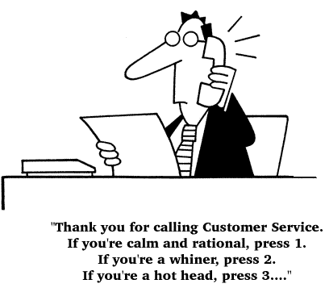
Play Nice
Complete the survey

Slide 12
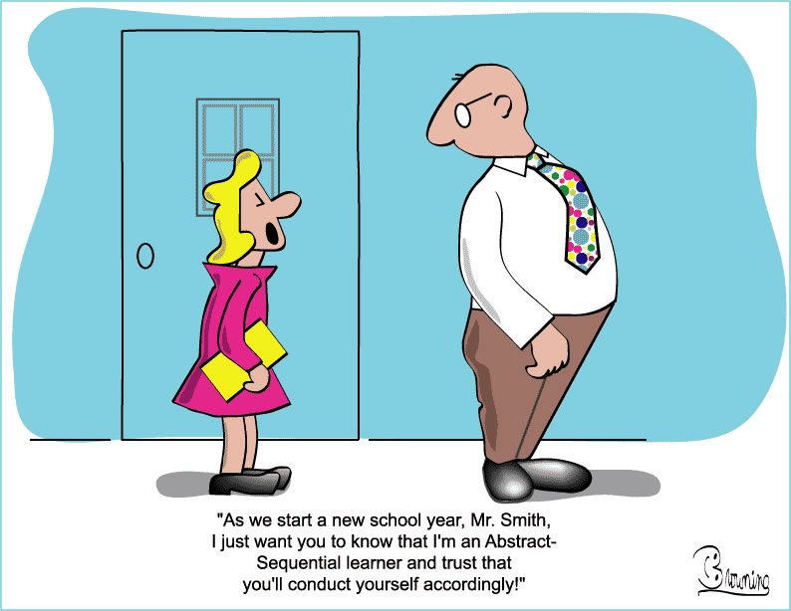
And, finally
Learn New STUFF
Be yourself

Slide 13
List of Questions

